Slide 1



H.C. Wainwright 4th Annual Neuropsychiatry Virtual Conference
June 26, 2023

Slide 2
Forward-Looking Statements
This release contains "forward-looking statements" that are made pursuant to the safe harbor provisions of the Private Securities Litigation Reform Act of 1995 and include statements that are not historical facts regarding our product development efforts, our strategic plans for developing products to treat CNS disorders, our ability to monetize non-core product candidates, the application of our Lip’ral platform in developing new treatments for CNS disorders, our product candidates and related clinical trials, the achievement of milestones within and completion of clinical trials, the timing and completion of regulatory reviews, outcomes of clinical trials of our product candidates, and the potential uses and benefits of our product candidates. Investors are cautioned that all such forward-looking statements involve risks and uncertainties, including, without limitation, the risks that we may not be successful in developing product candidates to treat CNS disorders, we may not be able to enter into partnerships or other strategic relationships to monetize our non-core assets, the FDA will not approve any of our products, risks related to our products, expected product benefits not being realized, clinical and regulatory expectations and plans not being realized, new regulatory developments and requirements, risks related to the FDA approval process including the receipt of regulatory approvals, the results and timing of clinical trials, patient acceptance of Lipocine’s products, the manufacturing and commercialization of Lipocine’s products, and other risks detailed in Lipocine’s filings with the SEC, including, without limitation, its Form 10-K and other reports on Forms 8-K and 10-Q, all of which can be obtained on the SEC website at www.sec.gov. Lipocine assumes no obligation to update or revise publicly any forward-looking statements contained in this release, except as required by law.

Slide 3

Investment Highlights
Near-Term
Value Events
Validated Proprietary Technology Platform
Enabling Effective Oral Delivery
Mid 2023
LPCN 1148: Phase 2 POC Cirrhosis Study Topline Results
Curated Clinical Development Focus
LPCN 1154: Fast Acting Oral Antidepressant
LPCN 1148: Unique MOA for Management of Cirrhosis
LPCN 2101: Novel MOA for Treating Women with Active Epilepsy
Exploratory Preclinical CNS Candidates
Q3 2023
LPCN 1154: FDA Meeting to Discuss Pivotal Study Design
Value Through Partnering of Non-Core Assets
Q4 2023
LPCN 1154: Confirmatory Pivotal PK Potential for First Subject Dosed
Testosterone Replacement Therapy: TLANDO® (Ex-US) and LPCN 1111
Prevention of Preterm Birth: LPCN 1107
Chronic Liver Disease: LPCN 1144, LPCN 1148

Slide 4
Curated Clinical Development Focus
Oral Neuroactive Steroids (NASs)
Significant Unmet Needs in Central Nervous System Disorders (CNS)
Psychiatry
Depression Disorders (e.g. PPD, MDD, TRD): Robust and durable efficacy, fast onset, good tolerability, improved compliance, affordable, and easy access
Neurology
Epilepsy: Novel MOA targeting women with active epilepsy (WWE)
Movement Disorders: No medications developed specifically for essential tremors (ET), only one approved >50 years ago
Large and growing CNS market
CAGR 9.4%
$166 bn
$89 bn
Targeting Differentiating Value Propositions
LPCN 1154
Oral postpartum depression (PPD) treatment option with high remission and faster onset
LPCN 2101
New MOA for treating women with active epilepsy
2021
2028
https://www.verifiedmarketresearch.com/product/central-nervous-system-therapeutics-market/

Slide 5
Lipocine Clinical Development Pipeline
Development Candidate (Indication) | Pre-Clinical | Phase 1 | Phase 2/POC | Pivotal | Approved | Status
LPCN 1154 (Postpartum Depression) |  |  |  |  |  | Initiate pivotal study, Q4 2023
LPCN 1148 (Liver Cirrhosis - Hepatic Encephalopathy; Secondary Sarcopenia) |  |  |  |  |  | Phase 2 POC topline results, mid 2023
LPCN 2101 (Women With Epilepsy) |  |  |  |  |  | IND cleared for Phase 2
Neuroactive Steroid |  |  |  |  |  | Exploratory

Slide 6
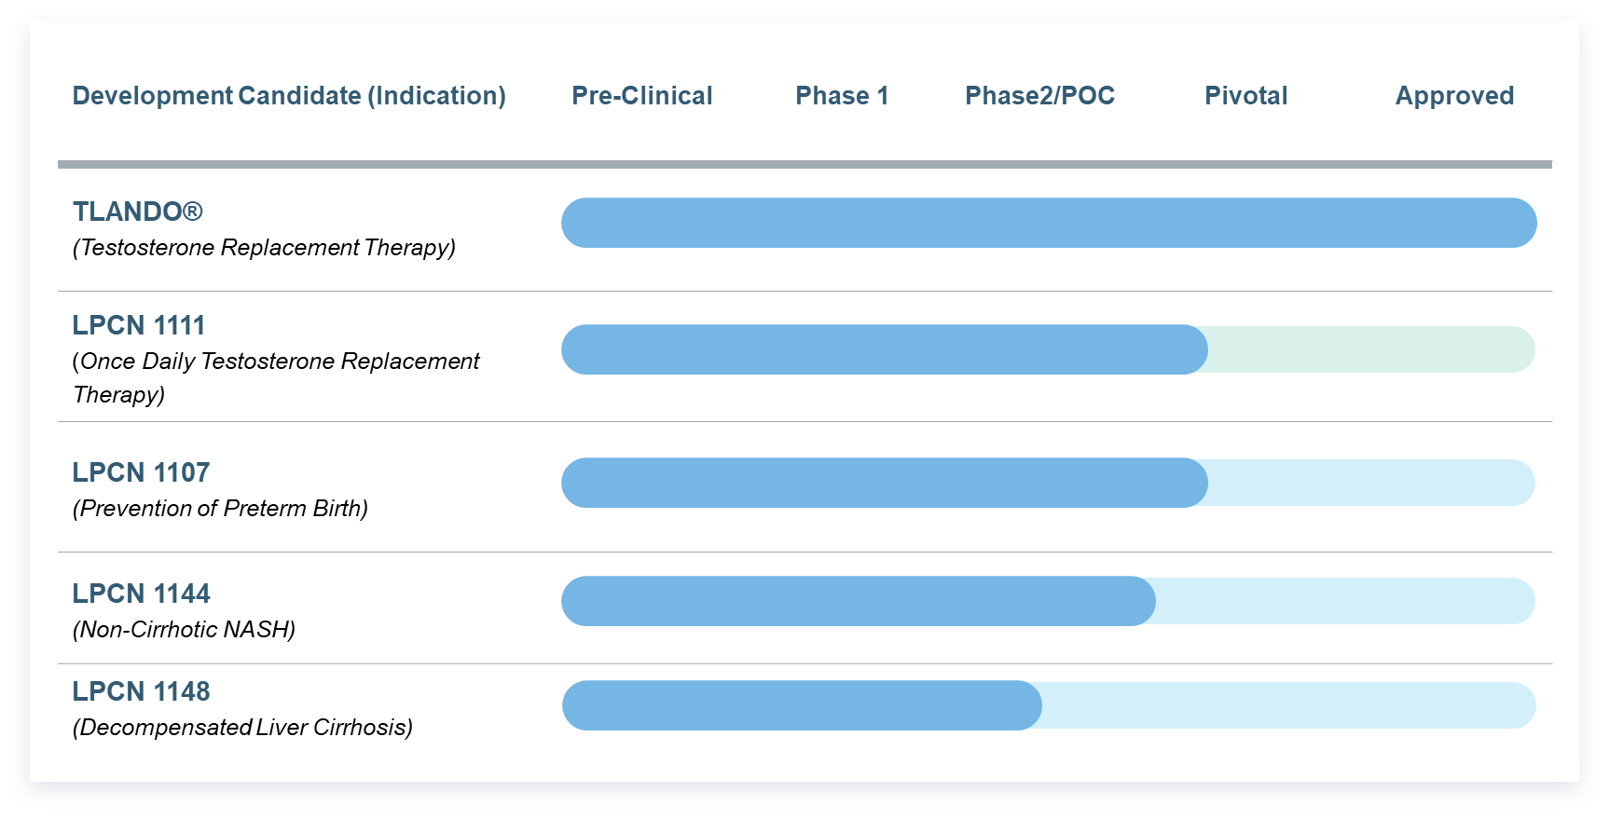
Unlocking Value Through Partnering
Why Partnering?
Assets for Partnering
  Enables focus on CNS opportunities
  Candidate advancement
  Risk diversification
  Potential for non-dilutive financing
  Improved resource management
(ex-US)

Slide 7

LPCN 1154
Oral Brexanolone for
Postpartum Depression (PPD)

Slide 8

Postpartum Depression (PPD)
A Major Depressive Disorder Within Weeks of
Childbirth
Estimated patients in the U.S. with PPD: ~500K annually¹
The prevalence of adolescent-onset PPD is two-folds higher than adult-onset PPD²
Suicide/suicide ideation, a significant concern: Suicide is a leading cause of maternal death in the first year following childbirth³
  Up to 30% of women with PPD experience suicidal ideations⁴
Warrants ensuring no harm done to mother and infant
Negative impact on family
Rapid Relief Matters
A Serious Condition in Need of a Highly Effective Fast-Acting Oral Treatment
CDC’s Pregnancy Risk Assessment: https://www.cdc.gov/reproductivehealth/depression/index.htm
sNDA 211371 S-007 Multi-disciplinary Review and Evaluation ZULRESSO (brexanolone) injection, for intravenous use
Chin et al. Curr Psychiatry Rep, 2022; 24(4):239-275
Mauri et al. Arch Womens Ment Health. 2012; 15(1): 39-47

Slide 9
Limitations of Current Pharmacological Treatment Modality for PPD
PPD – A Substantial Opportunity
SSRIs/SNRIs
Injectable Brexanolone
(Not approved for PPD indication, off label use)
(The only FDA approved treatment)
  Slow onset of antidepressant action – may take 4-6 weeks¹
  Treatment duration – acute for 6–8 weeks, followed by 4–9 months of continuation treatment²
  Efficacy – low pharmacotherapy response after 6-8 weeks²
  Tolerability – side effects such as sexual dysfunction and weight gain³; side effects upon discontinuation⁴
  Logistics of 60-hour IV infusion
  Inpatient administration
  ~40% of AEs are related to IV infusion administration errors⁵
  Frequent monitoring for excessive sedation
  Accessibility Challenges: Overnight stays; providers and facility certification; affordability
Market in Need of a Highly Efficacious, Fast-Acting, and Convenient Antidepressant
Boesen et al., Epidemiol Psychiatr Sci. 2021; 30, e35, 1-10.
Kennedy et al. J Psychiatry Neurosci. 2002 Jul;27(4):269-80.
Ferguson JM. Prim Care Companion J Clin Psychiatry. 2001 Feb; 3(1): 22–27.
Warner et al. Am Fam Physician. 2006;74(3):449-456
FDA Adverse Event Reporting System (FAERS) Public Dashboard
Notes:
Postpartum Depression (PPD) – A Substantial Opportunity

Slide 10
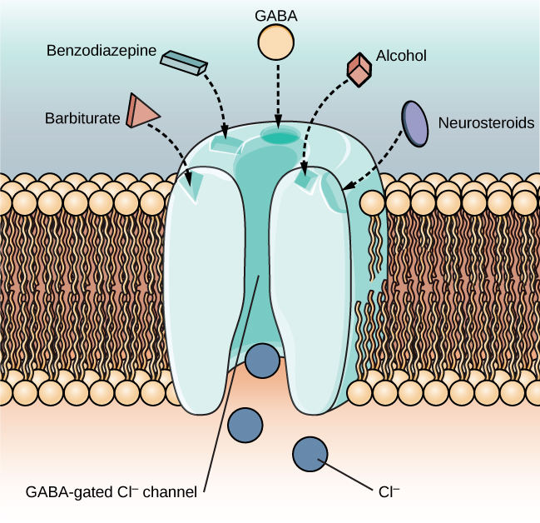
LPCN 1154
Strong Pharmacological Rationale
GABA Receptor Substrates Binding
Mechanism of Action
Brexanolone is a positive Allosteric Modulator (PAM) of the GABA_{A} receptor
Hormonal changes leading to GABA dysfunction are common in depression and pregnancy
https://opentext.wsu.edu/psych105nusbaum/chapter/substance-use-and-abuse/

Slide 11
LPCN 1154: A New Paradigm in Oral Treatment for PPD
Rapid Relief Matters
Product Candidate Attributes
Brexanolone Efficacy Advantage
Monotherapy or add-on therapy
Convenient oral for outpatient use
Bioidentical to naturally occurring neuroactive steroid, allopregnanolone
Brexanolone
Up to 75%¹ remission post treatment of
~3 days
Symptom Relief as early as 24h
Product Candidate Differentiation
Ideal for patients
in need of rapid relief with high remission rate and short treatment duration
with severe PPD; with acutely elevated suicide risk
No IV infusion challenges - anxiety, resource demands, preparation/administration errors, patient counseling, burdensome on family
No sexual dysfunction and weight gain side effects
SSRI/SNRI
ZuranoloneTM
Low² remission post acute treatment of 4-8 weeks
Remission of 19% at day 3 and 45% remission post 2 weeks ³
Remission defined as (HAMD-17 score ≤7)
LPCN 1154 target label based on Zulresso (sNDA 211371 S-007 Multi-disciplinary Review and Evaluation ZULRESSO),
Kennedy et al. J Psychiatry Neurosci. 2002 Jul;27(4):269-80.
Kristina M. Deligiannidis et al., JAMA Psychiatry. 2021 Sep; 78(9): 1–9

Slide 12
Pilot PK Bridge Study Results
Dosing Regimen Identified for Confirmatory PK Study
Comparative Exposure
Safety and Tolerability
LPCN 1154 was well-tolerated
All AEs were mild or moderate in severity
  AEs were similar across trial arms
  Majority (63%) AEs were venipuncture site pain (PK draws) or venipuncture site reactions (IV infusions)
No Serious Adverse Events were observed
No hypoxia or sedation-related adverse events were observed
No concerning safety signals related to vital signs were observed throughout the study
No dropouts - All participants completed all dosing periods
PK Parameter | Ratios (%) of geometric mean LPCN 1154 vs IV brexanolone
PK Parameter | DR 1 vs IV 60 µg* | DR 2 vs IV 90 µg
AUC∞ | 98% | 83%
C_{max} | 114% | 79%
PK Parameter | DR 1 vs IV 60 µg*
AUC∞ | 98%
C_{max} | 114%
Showed comparable PK exposure to both efficacious doses of IV Brexanolone (i.e., 60 µg /kg/hr and 90 µg /kg/hr)
*Interpolated from 90 µg/kg/hr IV infusion data
60 µg and 90 µg refer to the maximum dose in the IV regimen (60 µg /kg/hr and 90 µg /kg/hr)

Slide 13

LPCN 1154
Streamlined Pathway to NDA Submission Goal in 2024
Initiate 4Q 2023
Phase 1
Pilot PK Bridge Study
PK Pivotal Study
PK Pivotal Study
Successful single dose study completed Established feasibility of oral administration
Positive Topline Results
Required for NDA filing
Confirmatory trial to establish efficacy for NDA submission*
*Labeling studies may be needed for NDA submission

Slide 14

LPCN 1148
for the Management of Liver Cirrhosis
Hepatic Encephalopathy (HE)
Secondary Sarcopenia (SS)

Slide 15
Hepatic Encephalopathy, a Nervous System Disorder in Cirrhosis
Precipitation of HE due to Ammonia Buildup
Decrease in hepatic function
Dependence on muscle for detoxification
Systemic accumulation of ammonia
Hepatic Encephalopathy
Muscle-mass depletion
Bhanji et al. Hepatology International (2018) 12:377–386
Nusrat et al. World J Gastroenterol. 2014 May 14; 20(18): 5442–5460
Lattanzi et al. J Clin Exp Hepatol. 2019 Jan-Feb; 9(1): 125–130

Slide 16



Liver Cirrhosis Management – Opportunity
Prevalence
Standard of Care Limitations
Unmet Need
Over 2 million cases¹; 500k+ with decompensation²
62% on liver transplant waitlist are male³
40-70% of men with cirrhosis have sarcopenia^{4,5}
~30-40% of men with cirrhosis experience overt HE⁶
No approved drug for secondary sarcopenia (SS)
Rifaximin and lactulose for hepatic encephalopathy (HE)
Limited efficacy
Tolerability issues
SS: Improve survival/ quality of life for patients on transplant list
Improvement of post-transplant outcomes /lowered cost of care
HE: Novel MOA
1. Moon, Clin Gas and Hep, 2019. 2. GBD 2017 Cirrhosis Collaboration, Lancet, 2021. 3. Sarkar et al. J Hepatol. 2015
4. Sinclair, Ailment Pharmacol Ther, 2016. 5. Lai, Am J Transplant, 2014. 6. Grønkjær et al., Gastroenterol Nurs. 2018 Nov/Dec;41(6):468-476.

Slide 17
LPCN 1148
Management of Liver Cirrhosis: Hepatic Encephalopathy; Secondary Sarcopenia
Product Candidate Attributes
Androgen receptor agonist
Oral dosage form comprising testosterone laurate, a unique prodrug of endogenous testosterone
Potential for Orphan Drug Designation
Product Candidate Differentiation
Novel Multi-Modal MOA
Only candidate in development for secondary sarcopenia in cirrhosis - no approved SOC

Slide 18
LPCN 1148 - Novel Multi-Modal Mechanism of Action for Liver Cirrhosis
Anabolic¹
Increase muscle mass and strength²; Reduce fat mass³; Increase bone density⁴; Inhibit myostatin⁵; Improve appetite and nutritional status*
Androgenic
Anti-Inflammatory^{8,9}
Reduce IL-1, IL-6, and TNF-α¹⁰
Improve immuno-dysregulation¹¹
Induce hematopoiesis⁶; Improve endocrine/sexual dysfunction⁷
Protein Modulation
Albumin increase; Muscle protein synthesis; Lower SHBG
Lower infection rate
Ammonia Detoxification
Improve liver health; Improve muscle disorders; Antibacterial
Gentile MA et al., J Mol Endocrine, 2010
Sinclair et al., J Gastroenterol Hepatol 2016
Shalender Bhasin, Clin Infect Dis. 2003;37 Suppl 2:S142-9
Snyder et al. JAMA Intern Med. 2017 Apr 1;177(4):471-479
Dasarathy and Merli, J Hepatol. 2016
Basaria, S., Dobs, A.S. (2003). Androgens and the Hematopoietic System. In: Bagatell, C.J., Bremner, W.J. (eds) Androgens in Health and Disease.
Rizk et al., Curr Opin Urol 2017
Kelly and Jones, J Endocrinol, 2013
Zhang et al., J Cardiovasc Pharmacol Ther. 2021 Nov;26(6):638-647
Mohamad et al. Aging Male. 2019 Jun;22(2):129-140.
Nakashima et al., Kidney Int Rep. 2017 Nov; 2(6): 1160–1168
*individual's health condition as it is influenced by the intake and utilization of nutrients

Slide 19
LPCN 1148 - Development Status
POC Topline Results Expected in Mid-2023
Endpoints:
Phase 2 POC study (NCT04874350)
Randomized placebo-controlled study in sarcopenic male patients with cirrhosis
Primary: Change in Skeletal Muscle Index at Week 24
Key Secondary: Overall survival, hospitalization rates
    Change in number of waitlist events
    Rates of breakthrough hepatic encephalopathy/ascites
    Change from baseline in Liver Frailty Index, Myosteatosis
    Patient Reported Outcomes (PRO’s)
SCREENING
TREATMENT: 52 WEEKS
LPCN 1148
Medical History
Labs
Imaging
Placebo
LPCN 1148
Randomize
24-Week Analysis
52-Week Analysis

Slide 20
LPCN 2101
for Women With Active Epilepsy (WWE)
Notes:
Review the disease, Limitations of SOC is and unmet need in treating WWE

Slide 21
Women with Epilepsy (WWE) of Childbearing Age
Treatment Challenges for WWE
Pregnancy
• Fetal/neonatal toxicity
• Adherence to AEDs
• Lowest effective dose,
monotherapy AED
preferred
Pre-Pregnancy
• Planned pregnancy
- AED selection
• Unplanned pregnancy
- Contraception failure
Comorbidities
• Anxiety
• Depression
Seizure Control
• Drug-drug interaction
AED = Antiepileptic Drug
S.Bangar et al. Functional Neurology 2016; 31(3): 127-134
Reimers et al. Seizure. 2015 May;28:66-70.

Slide 22



Women with Epilepsy (WWE) of Childbearing Age - Opportunity
Prevalence
Standard of Care Limitations
Unmet Need
~ 900,000 of women of childbearing (CB) suffer from active epilepsy in US^{1,2}
~ 80% of WWE reported at least one unintended pregnancy³
Depression is the most frequent psychiatric comorbidity in epilepsy⁴
No drug approved specifically for WWE
Most approved ASMs have fetal toxicity risk
~ One third of adult patients are non-responsive⁵
Limited options to address mood disorder comorbidities
Drug-drug interaction risk
Seizure control with low/no teratogenic risk
Address special considerations for WWE
Novel MOA
Address associated mood disorders
1. https://www.statista.com/statistics/241488/population-of-the-us-by-sex-and-age/
2. https://www.cdc.gov/mmwr/volumes/66/wr/mm6631a1.htm
3. Herzog et al. Neurology. 2017 Feb 21;88(8):728-733
4.Kanner AD, Epilepsy Curr. 2006 Sep; 6(5): 141–146
5. https://www.epilepsy.com/treatment/medicines/drug-resistant-epilepsy
Notes:
900k women of CB age suffer from active epilepsy, with 80% reporting at least one unintended pregnancy
ASM's have fetal toxicity risk
Currently no drug approved for WWE, and current approved ASMs have drug-drug interaction risk
There is an unmet need for seizure control with low/no tratogenic risk that address the special considerations for WWE

Slide 23
LPCN 2101
Novel Potential Alternative for WWE
Endogenous Neuroactive Steroid Alternative for WWE
Product Candidate Attribute
Positive Allosteric Modulator (PAM) of the GABA_{A} receptor
Oral dosage form comprising a neuroactive steroid
Product Candidate Differentiation
Novel MOA specifically addressing WWE unmet needs
Active is endogenous to women
Potential to address psychiatric comorbidities (depression, anxiety, sleep disorders)
Potential for favorable drug-drug interactions
Notes:
NAS has shown promise of efficacy thru GABA modulation
Endogenous molecule: not foreign to women of CB age
NAS has potential to address serious co-morbidities associated in WWE
Potential of falls and ASMs treatment issues - toxicity risk, driving limitations, requirement for monitoring
Drug dug interaction impacting efficacy and contraception failure

Slide 24
Exploratory Candidate
Notes:
Review the disease, Limitations of SOC is and unmet need in treating WWE

Slide 25
Oral Brexanolone for Depression Disorders
A New Paradigm in Oral Treatment for Depression
Target attributes: Fast onset, robust efficacy, and durable response
Major Depressive Disorder (MDD)
  21.0 million adults in U.S. (8.4% of all adults) had at least one major depressive episode
  Globally, an estimated 5% of adults suffer from depression
  A leading causes of disability worldwide
Treatment-resistant major depressive disorder (TRD)
  1/3rd of patients with MDD do not experience adequate relief of depressive symptoms after treatment with multiple therapies and are considered to have TRD
  7-fold higher suicide rate, lower remission rates, higher relapse rate, pronounced functional impairment, and substantially lower quality of life, compared to patients with MDD who respond to antidepressant treatment
  Approximately 2.8 million in US
Generalized anxiety disorder (GAD) in MDD
  GAD and MDD are commonly co-occurring disorders
Brexanolone is an approved neuroactive steroid for depression, a validated unique MOA
https://www.nimh.nih.gov/health/statistics/major-depression
https://www.who.int/news-room/fact-sheets/detail/depression

Slide 26
Investment Highlights
Near-Term
Value Events
Validated Proprietary Lip’ral Technology Platform
Enabling Effective Oral Delivery
Mid 2023
LPCN 1148: Phase 2 POC Cirrhosis Study Topline Results
Curated Clinical Development Focus
LPCN 1154: Fast Acting Oral Antidepressant
LPCN 1148: Unique MOA for Management of Cirrhosis
LPCN 2101: Novel MOA for Treating Women with Active Epilepsy
Exploratory Preclinical CNS Candidates
Q3 2023
LPCN 1154: FDA meeting to discuss Pivotal Study Design
Value Through Partnering of Non-Core Assets
Q4 2023
LPCN 1154: Confirmatory Pivotal PK Potential for First Subject Dosed
Testosterone Replacement Therapy: TLANDO® (Ex-US) and LPCN 1111
Prevention of Preterm Birth: LPCN 1107
Chronic Liver Disease: LPCN 1144, LPCN 1148

